Slide 1
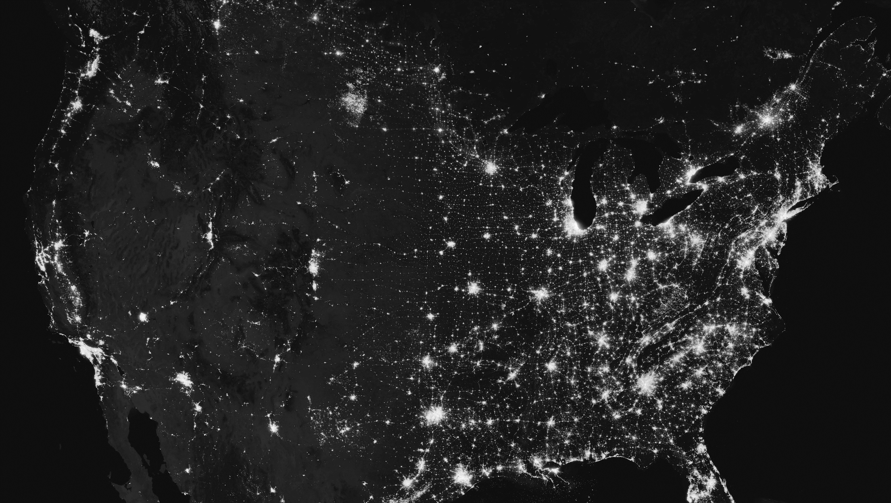
Using Machine Learning Models in Infectious Diseases Prediction with Economic Constraints
Presented by: Dr. Teddy Lazebnik (University College London, Cancer Institute)

Slide 2





Agenda
Motivation and introduction
Pandemic spread and control models
Summary and “take home” message
Biological & Mathematical Background
Some results & cool graphs

Slide 3
Epidemiology – The Ultimate Multi-disciplinary Question
Biology
Healthcare
Incubation duration, infection course, mutation dynamics
Clinical stages, available treatments, prevention methods
Epidemiology
Sociology
Mathematics
Occurrence
Spread
Control
Population interactions, obedience to policies
Study dynamics, predicting spread, intervention policy design
Economic
Computer Science
Economic damage, intervention policy resource demandance
Data-driven modeling and policy optimization, information systems

Slide 4




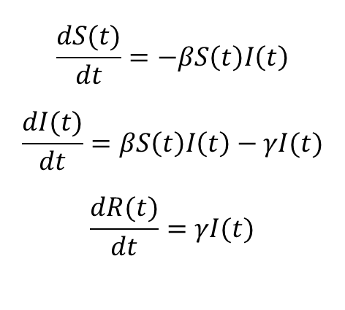
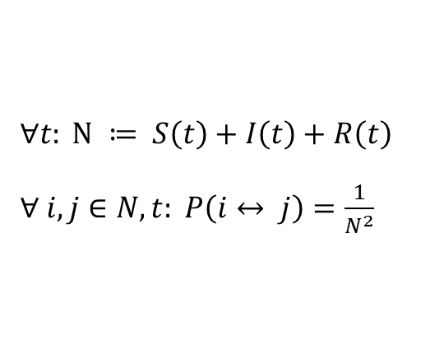
Mathematically Modeling Pandemic Spread
Susceptible
Infected
Recovered
$$\frac{dS(t)}{dt}=−βS\left(t\right)I\left(t\right)$$
$$\frac{dI(t)}{dt}=βS\left(t\right)I\left(t\right)−γI(t)$$
$$\frac{dR(t)}{dt}=γI(t)$$
$∀t: N ≔ S\left(t\right)+I\left(t\right)+R\left(t\right)$
$∀ i, j∈N, t: P\left(i↔ j\right)=\frac{1}{N^{2}}$
Exposed
Vaccinated
Social network
Movement
* all images are licensed as free to use

Slide 5
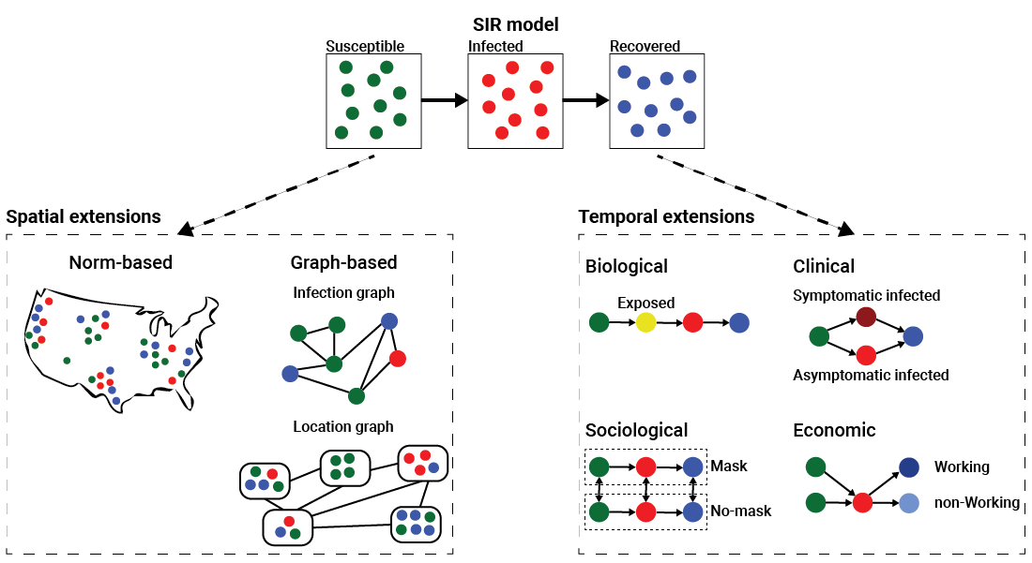
Mathematically Modeling Pandemic Spread – extending SIR

Slide 6
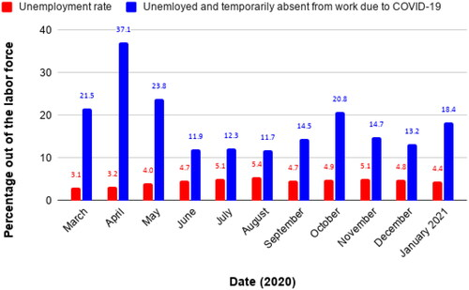
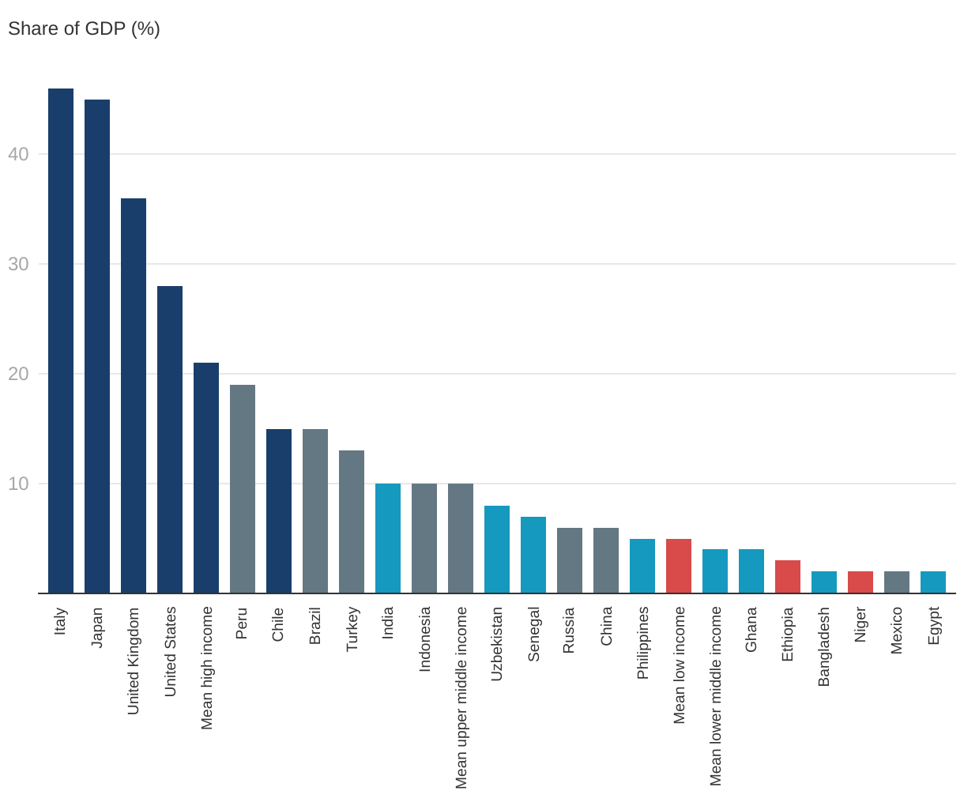
It is (Almost) Always About The Money
Economic damage due to the pandemic
Economic spends due to the pandemic
Share of GDB (%)
40
30
20
10
Data source: Central Bureau of Statistics, Israel
Data source: World Bank, World development report 2022

Slide 7
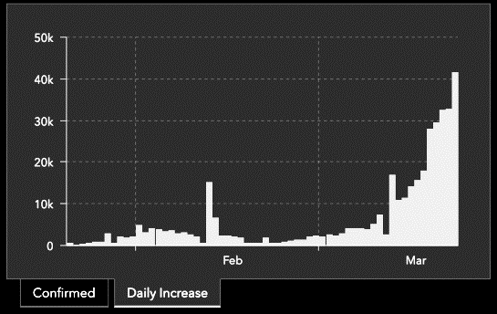


Integrating Machine Learning To The Mix
* The image is licensed as free to use

Slide 8
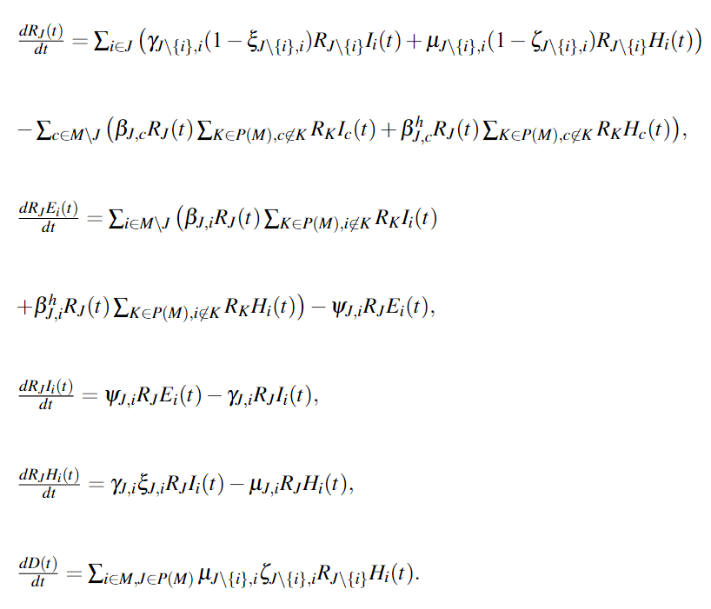
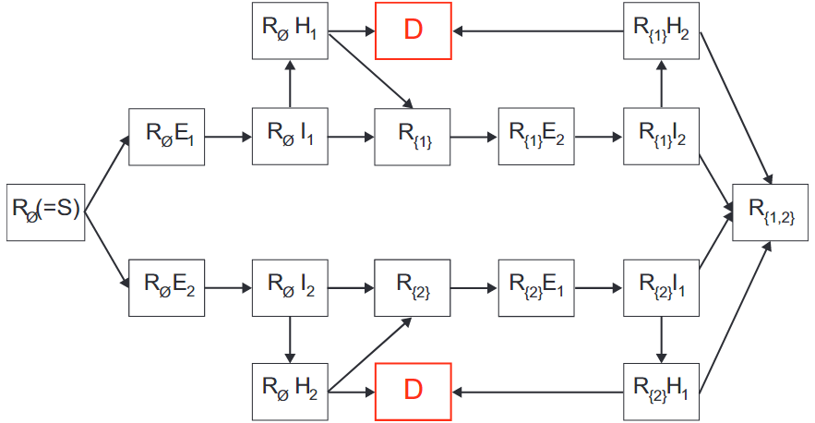
Economic Aspects of the Detection of New Strains in a Multi-Strain Model
Transition between disease stages, shown for $\left|M\right|=2.$
* Shami, L., Lazebnik, T. (2023). Economic aspects of the detection of new strains in a multi-strain epidemiological–mathematical model, Chaos, Solitons & Fractals.

Slide 9


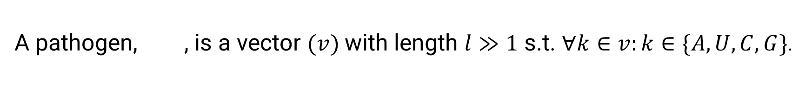
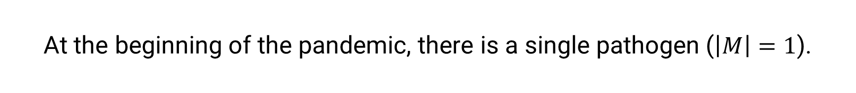
Economic Aspects of the Detection of New Strains in a Multi-Strain Model
At the beginning of the pandemic, there is a single pathogen ($\left|M\right|=1$).
A pathogen, , is a vector $(v)$with length $l≫1$ s.t. $∀k∈v:k∈\{A, U,C,G\}$.
A new strain is emerged from a mutation process that occur once:
$m_{new}↔∀m∈M:\left|\left|m_{new}−m\right|\right|>α$ for pre-defined $α$ value

Slide 10


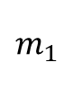
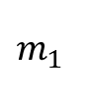
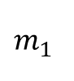
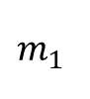
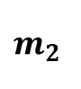
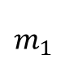
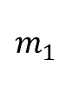
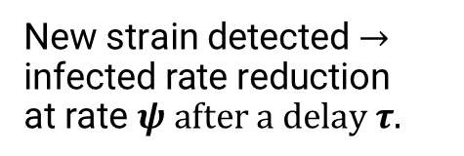
Economic Aspects of the Detection of New Strains in a Multi-Strain Model
Pandemic Intervention Policy
(PIP)
$$m_{1}$$
$$m_{1}$$
Sample
$$m_{2}$$
$$m_{1}$$
$$m_{1}$$
No new strain detected
$$m_{1}$$
New strain detected $→$
$$\text{infected} \text{rate} \text{reduction}$$
$$\text{at} \text{rate} ψ after a delay τ.$$
$$m_{1}$$

Slide 11

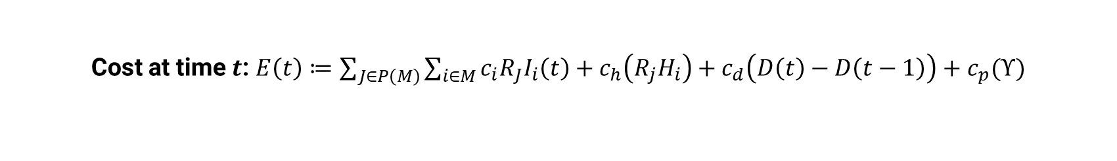
Economic Aspects of the Detection of New Strains in a Multi-Strain Model
Hospitalization cost: $∀J∈P\left(M\right), i∈M: c_{h}\left(H_{J,i}\right)≔a_{1}H_{J,i}^{1+b}$+ $a_{2}H_{J,i}^{}+a_{3}$
PIP testing cost of population of size $x$: $c_{p}\left(x\right)≔f_{1}x+f_{2}−f_{3}ln⁡(x)$
Cost at time $t$: $E\left(t\right)≔\sum_{J∈P\left(M\right)}{\sum_{i∈M}{c_{i}R_{J}I_{i}\left(t\right)+c_{h}\left(R_{j}H_{i}\right)}+c_{d}\left(D\left(t\right)−D\left(t−1\right)\right)+c_{p}(Υ)}$
$Total pandemic cost$: $E≔\sum_{t∈[t_{o},t_{f}]}{E(t)}$

Slide 12
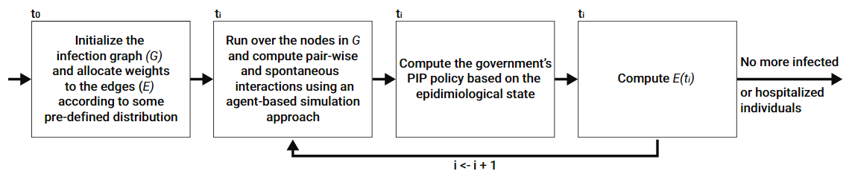
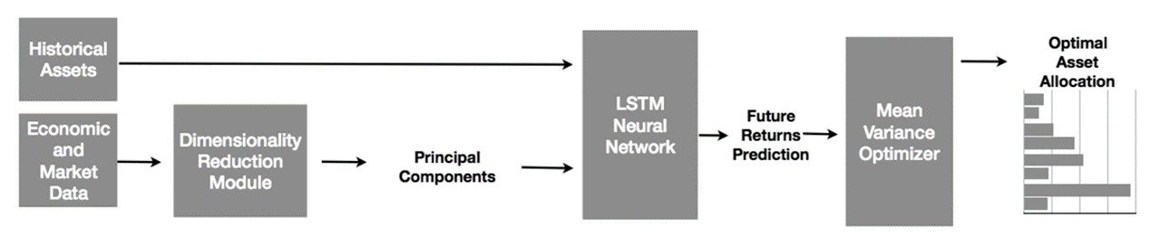
The Simulating and Learning Loop
* The image from Obeidat et al. (2018). Adaptive Portfolio Asset Allocation Optimization with Deep Learning. International Journal on Advances in Intelligent Systems, 11(1-2):25-34.

Slide 13
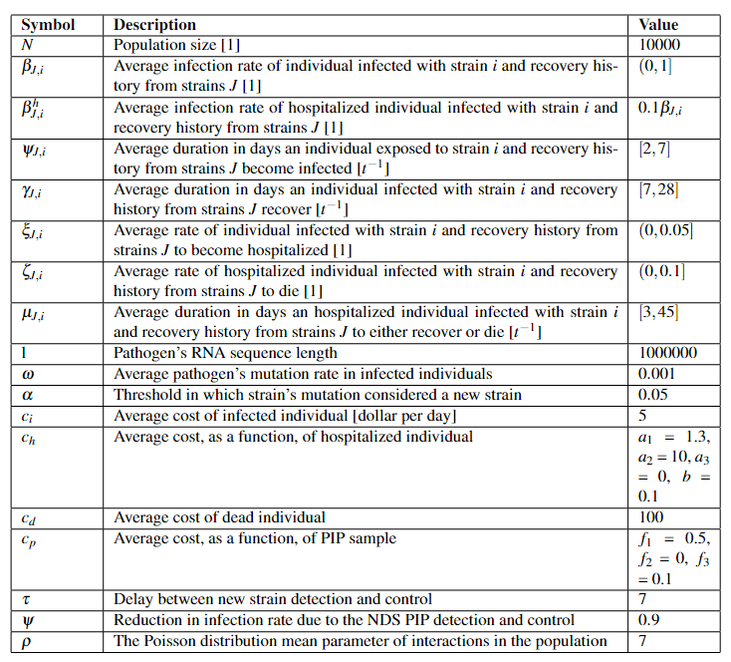
Show, Don’t Tell – Values

Slide 14
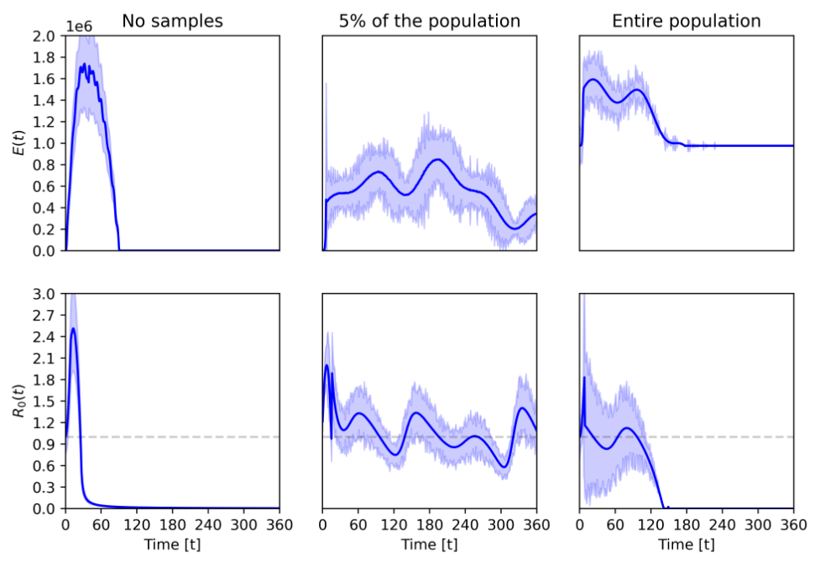
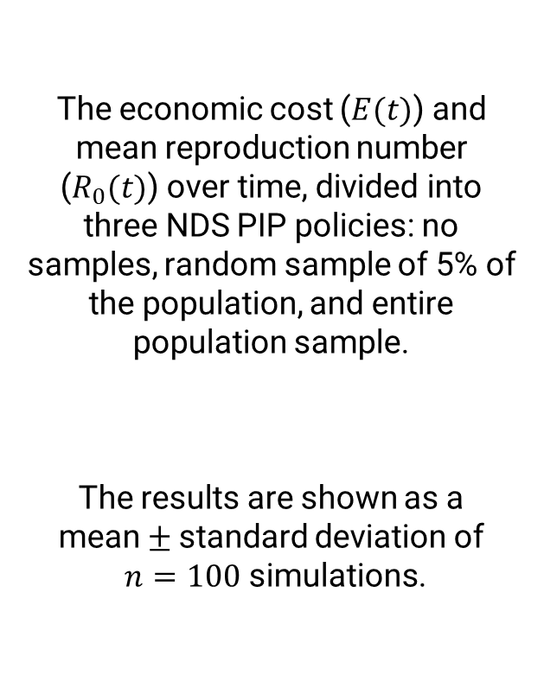
Show, Don’t Tell – Baseline
The economic cost ($E(t)$) and mean reproduction number ($R_{0}(t)$) over time, divided into three NDS PIP policies: no samples, random sample of 5% of the population, and entire population sample.
The results are shown as a
mean $±$standard deviation of
$n=100$ simulations.

Slide 15
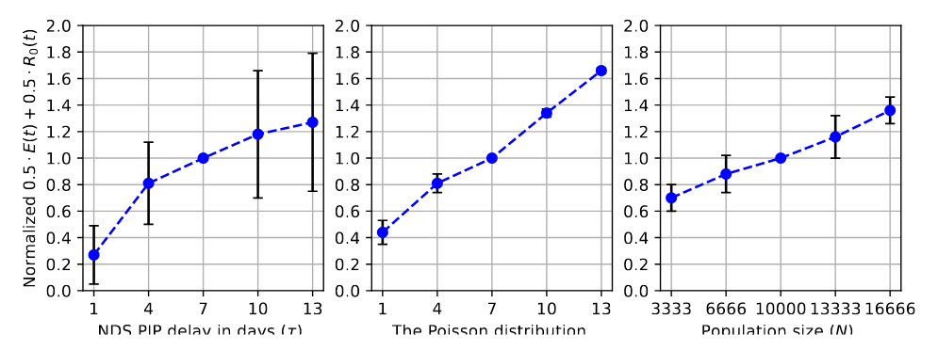
Show, Don’t Tell – Sensitivity Analysis

Slide 16
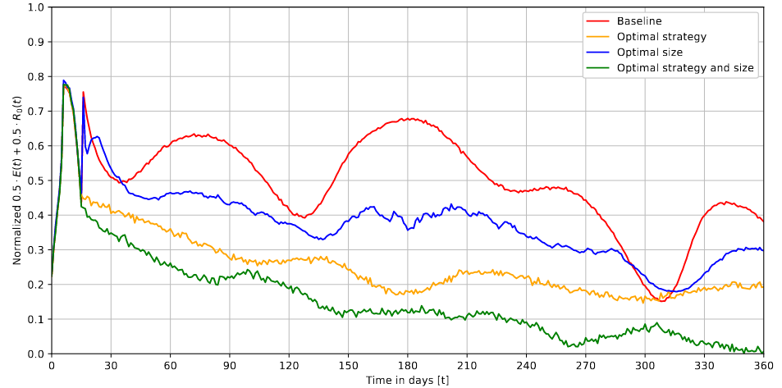
Show, Don’t Tell – Policy Optimization

Slide 17
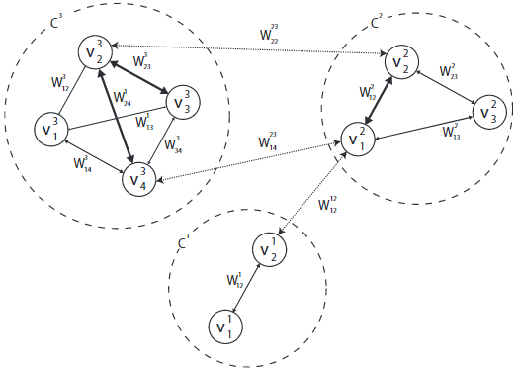
Several More Ideas
Border Closure for International Tourism During Pandemic

Slide 18
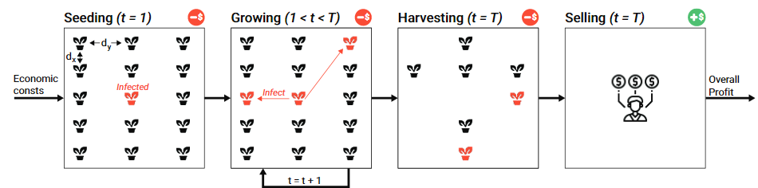
Several More Ideas
Cost-optimal Seeding Strategy During a Botanical Pandemic in Domesticated Fields

Slide 19
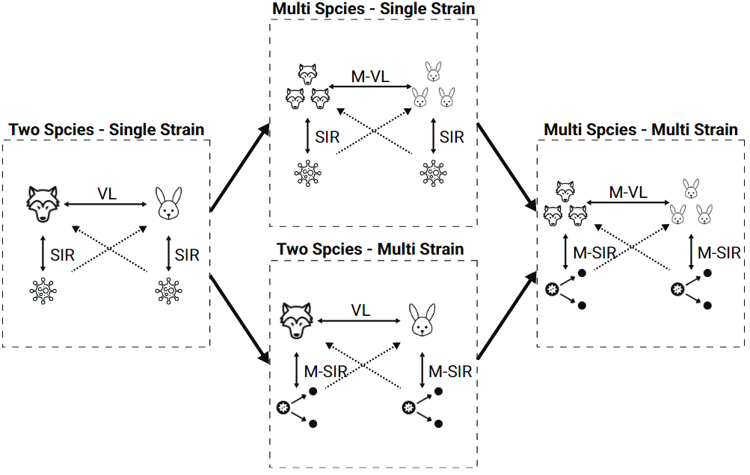
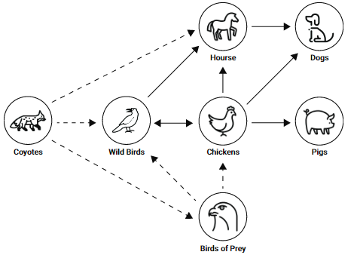
Several More Ideas
Multi-Species Pray-Predator Dynamics During a Multi-Strain Pandemic

Slide 20





Acknowledgements
Dr. Labib Shami
Western Galilee College, Economics
Ariel Alexi
Bar Ilan University, Information Science
Dr. Svetlana Bunimovich
Ariel University, Mathematics
Dr. Uri Itay
Mathematician, speaker, algorithm developer and a data scientist
Dr. Ariel Rosenfeld
Bar Ilan University, Information Science

Slide 21


I am always looking for existing collaborations and research projects! If you have one, feel free to PM me
Lazebnik.teddy@gmail.com
https://teddylazebnik.com
Epidemiology is hard
ML for policy design
Solve specific tasks
There are too many process that are unknown, making the data gathering, feature engineering, and modeling an open research question
Previous attempts to use DL/ML for spread prediction and/or control has mainly failed. However, policy optimization and model fitting can extremely benefit from ML
Epidemiological systems are chaotic in nature. Trying to model everything with big computer usually results in a mess. Focus on what important and solve one task at a time

